Slide 1
Python and SQL

Slide 2
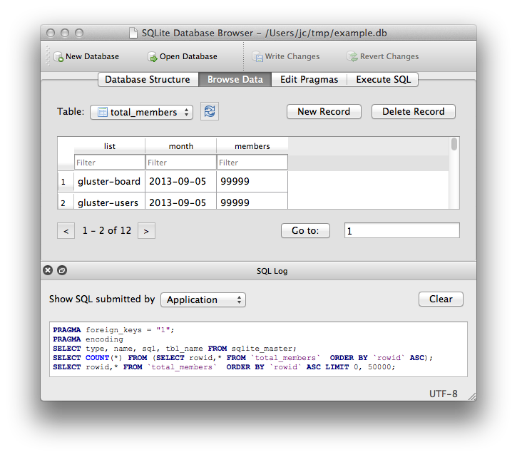
Before we start https://sqlitebrowser.org/
Download this handy database tool, you can make , edit and explore a database and run SQL
Perfect for a python project

Slide 3
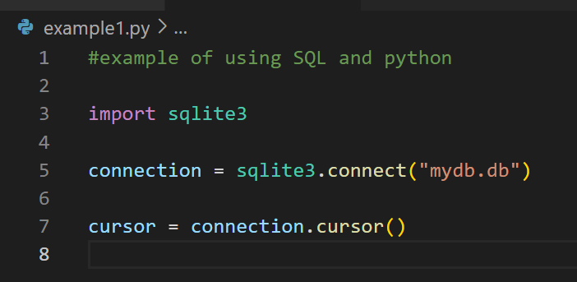
Let set up a basic database - mydb.db

Slide 4
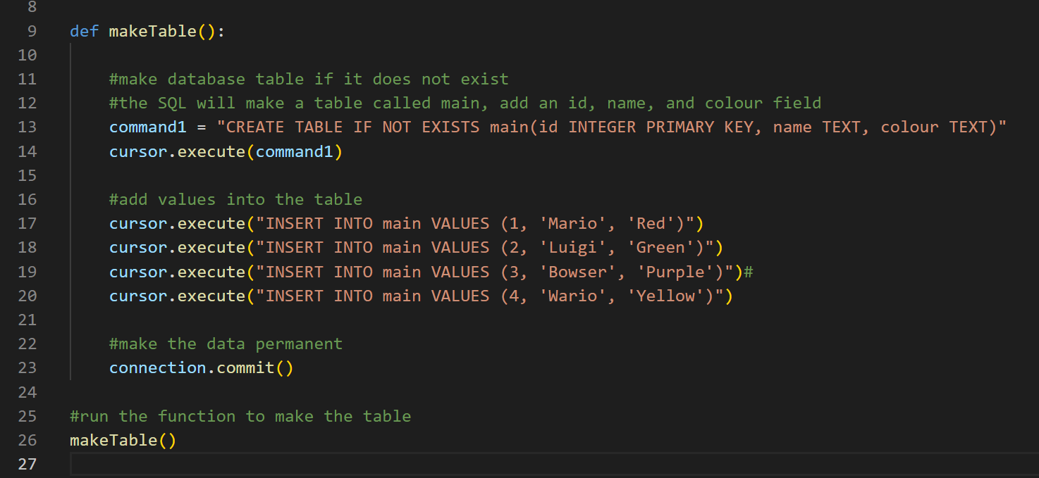
Now let’s make a table and add the data - add this ….

Slide 5
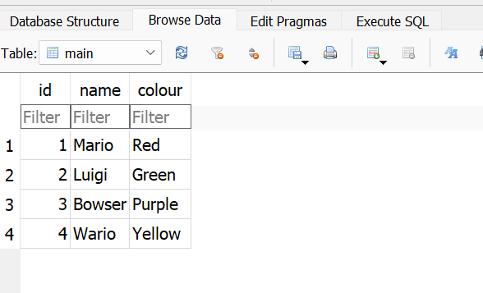
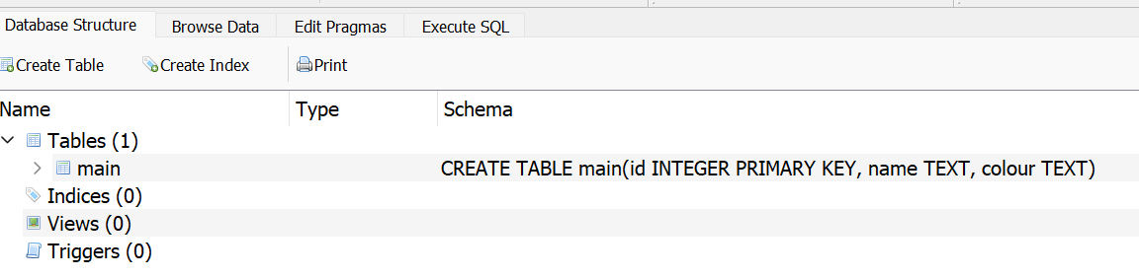
Examine the Database with DB Browser

Slide 6
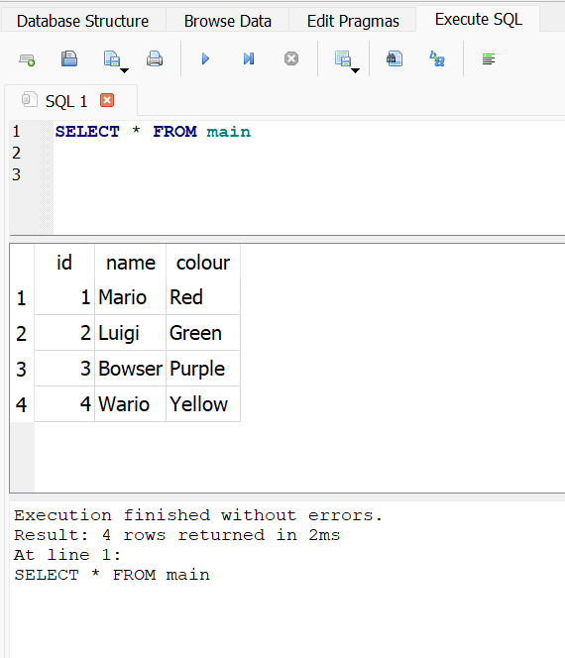
Lets run a SQL query
SELECT * FROM main
* means ALL
main is the name of the table.
So select everything from the table.

Slide 7
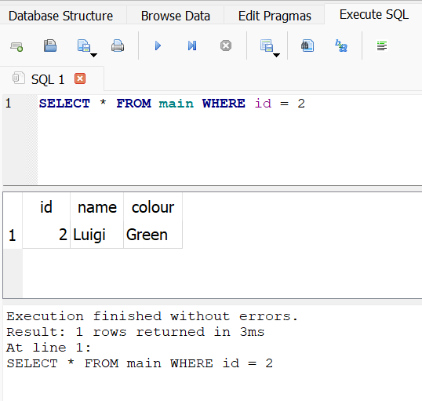
Let’s find a specific record of data from its id
Return all the record where it matches with an id of 2
There should be no duplicate id’s and it should return only 1 record.
Eg - finding a user in a database

Slide 8
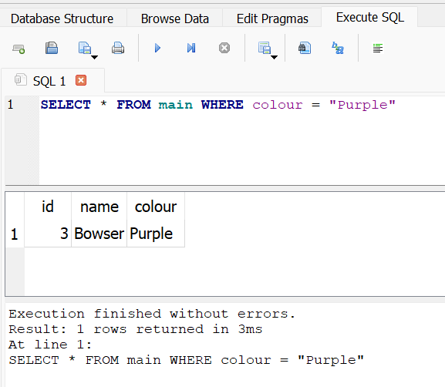
In this example we match the colour - there could be more with the same colour.
This would be to check a Username, and then use this to check the password matches.
(the password would not be stored as a word in cleartext - it would be hashed first for security reasons - even the database administrator won’t know what your password is. They can only check that your password is a valid match after your input is also hashed)

Slide 9
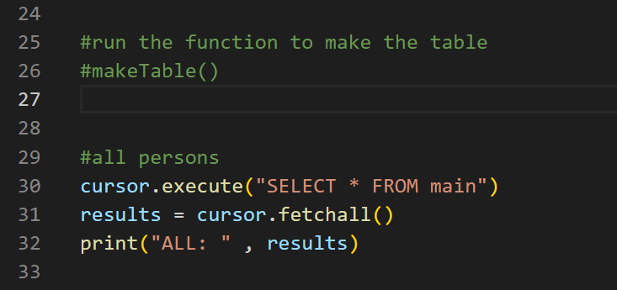

Now lets run the queries in python
We have commented out
#makeTable() as we don’t want to run this again as we have already entered the data.

Slide 10
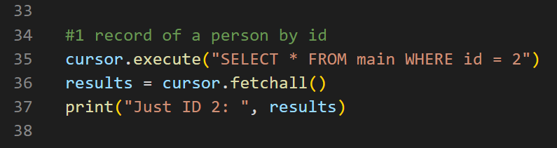
Record by ID

Slide 11
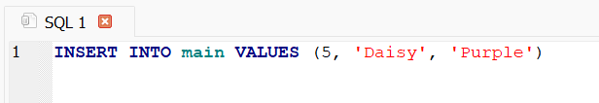

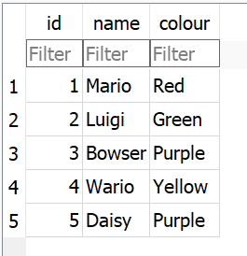
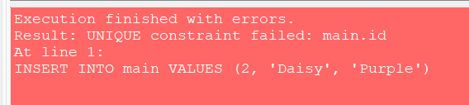
Now it’s your turn to write a query to sort by Purple!
Maybe add a few more into the table - try this in the DB Browser so you don’t need to run the makeTable function.
The value 2 is invalid as it is a primary key and is a unique value. The database does not allow this to be entered. The other values can be duplicated.

Slide 12
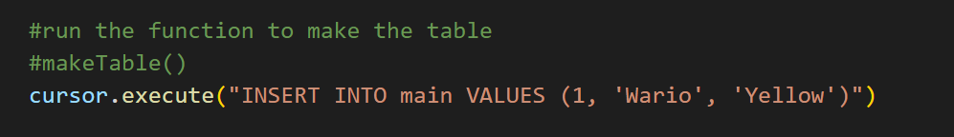
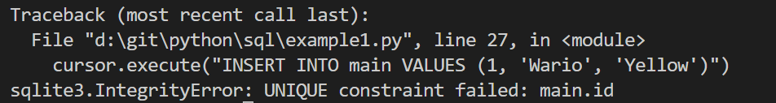
Errors
Adding a invalid key will also fail in python

Slide 13
One last thing….
You can’t add any data into the database with python if you have it open in the DB viewer… as the file will be locked!
So you need to close the viewer while running any SQL that will write to the database.
There are many more SQL queries you can try! Have a go and see what you can do! https://www.w3schools.com/sql/sql_syntax.asp

Slide 14
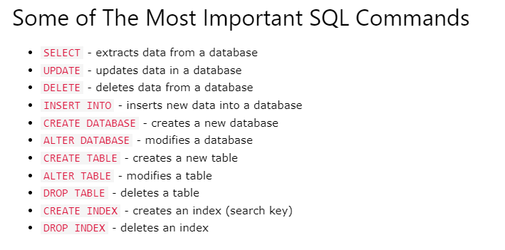
https://www.w3schools.com/sql/sql_syntax.asp

Slide 15
Auto Increment PK

Slide 16
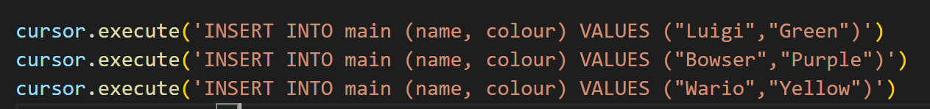
AUTOINCREMENT
We specify the (name, colour) and the VALUES for them
The id will automatically increment.

